Slide 1

Pothole and Speed Breaker Detection and Alert System
C09
Team Members:
M. Snehitha (247R1A66G5),
M. Sriram Reddy (247R1A66G6),
S. Arun (247R1A66J4)
B. Laxman (257R5A6616)
Under the Guidance of
B. Swaroopa Rani Assistant professor
Department of CSE(AI&ML)

Slide 2
Table of Contents
Abstract
Existing System and Disadvantages
Proposed System and Advantages
System Architecture
UML Diagrams–
Use Case Diagram
Class Diagram
Sequence Diagram Component Diagram
Activity Diagram
6.Implementation
7. Results
8. Conclusion
9. Future Scope
10. References

Slide 3
Abstract
This project focuses on the design and development of an IoT based pothole and speed breaker detection system using an ESP32 microcontroller.
The system continuously monitors road surface conditions using ultrasonic sensors to identify sudden height and depth variations.
Bluetooth communication enables remote control of the robotic platform through a mobile application.
Upon detecting a pothole or speed breaker, the system activates a buzzer and sends alert information to the mobile device that helps to reduce the accident risks.

Slide 4
Existing System
Road potholes and speed breakers are currently identified manually by drivers through visual observation.
Such methods depend heavily on visibility and driver attention, especially during night-time and adverse weather conditions.
There is a lack of affordable and automated real-time road hazard detection systems.
Manual detection often leads to vehicle damage, discomfort, and increased accident rates.
The existing approach is unreliable, inefficient, and unsafe.
Although this ADAS system remains to only expensive vehicles .

Slide 5
Disadvantages:
No real-time detection or alert mechanism for road hazards.
High dependency on human judgment and visual clarity.
Increased risk of accidents and vehicle maintenance costs.
Ineffective during low visibility conditions such as fog or rain.
Not suitable for modern smart transportation requirements.
Existing closer system like ADAS will be in higher costs execution.

Slide 6
Proposed System
The proposed system employs an ESP32 microcontroller integrated with ultrasonic sensors for road surface analysis.
It detects potholes and speed breakers by analyzing distance variations from the road surface.
The robotic platform is remotely controlled via Bluetooth using a mobile application.
A buzzer provides immediate audible alerts when hazards are detected.
Alert data is simultaneously transmitted to the user's mobile device through Bluetooth.

Slide 7
Advantages of Proposed System
Provides real-time detection and alerting of road hazards.
Improves overall driving safety and reduces accident risks.
Low-cost, portable, and easy to implement solution.
Supports Bluetooth-based remote control and communication.
Suitable for smart transportation and road monitoring systems.

Slide 8
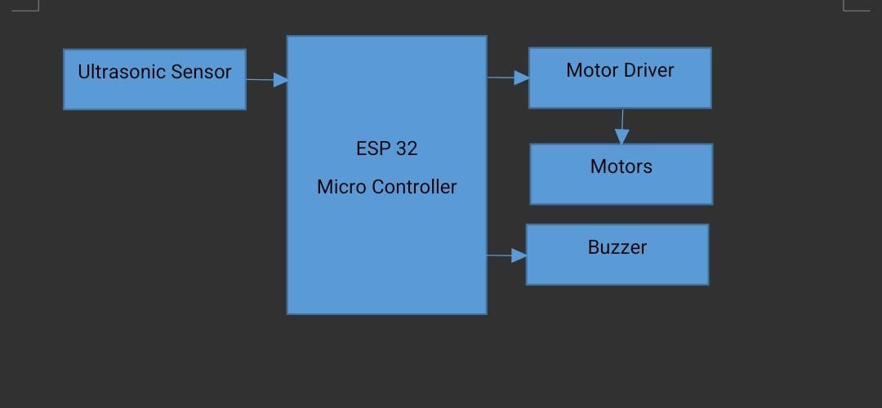
System Architecture

Slide 9
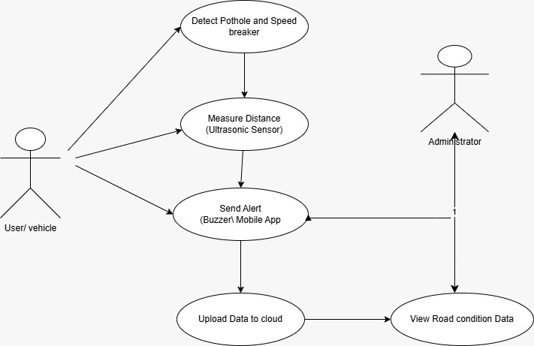
Use Case Diagram

Slide 10
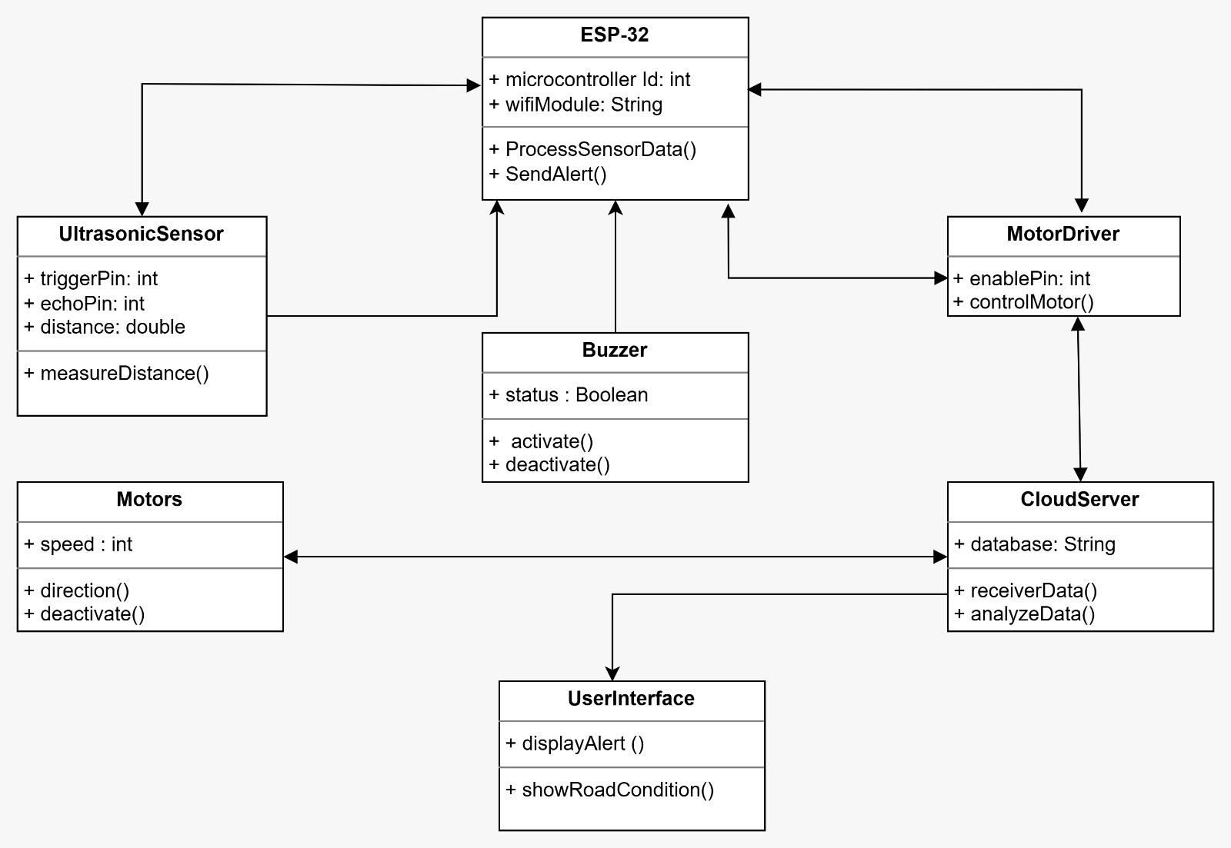
Class Diagram

Slide 11
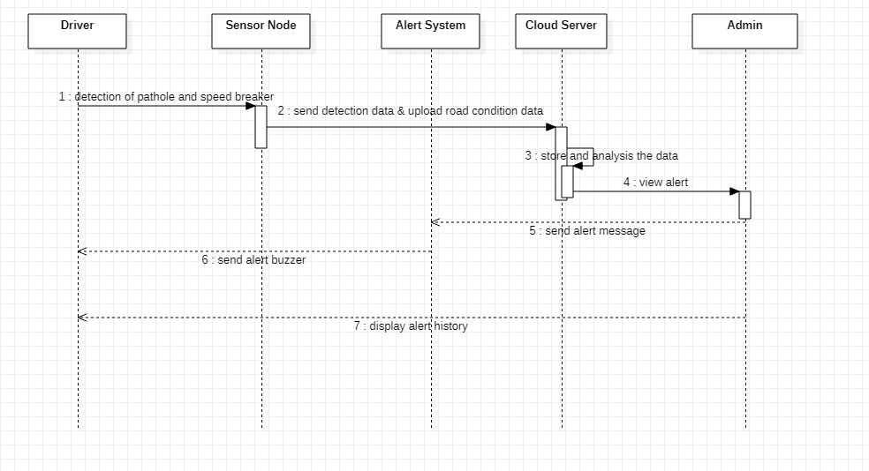
Sequence Diagram

Slide 12
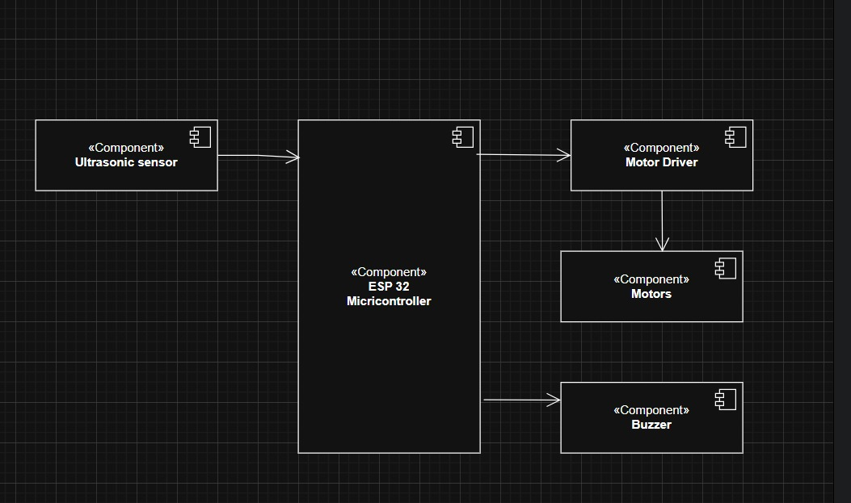
Component Diagram

Slide 13
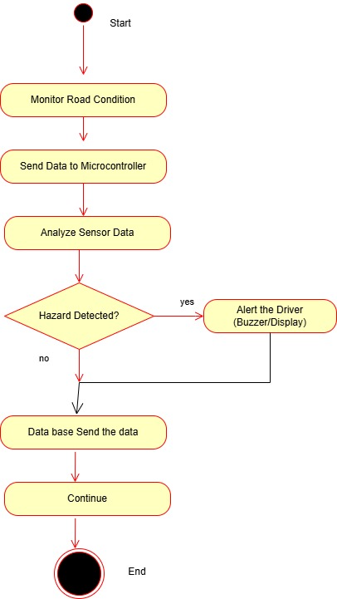
Activity Diagram

Slide 14
Implementation

Slide 15
Result

Slide 16
Conclusion
The proposed pothole and speed breaker detection system provides an effective and economical solution for road safety enhancement.
By integrating sensors, wireless communication, and embedded control, the system ensures timely hazard detection.
The project demonstrates the practical application of IoT and embedded systems in real-world transportation problems.
Future enhancements may include GPS integration, cloud connectivity, and improved sensor accuracy.

Slide 17
Future Scope
Integration of GPS for location tracking
Use of IoT & Cloud for real-time data storage and monitoring
Development of Mobile App for alerts and road condition display
Use of Advanced Sensors to improve detection accuracy
Implementation of Machine Learning for smart decision-making
Direct installation in vehicles for automatic monitoring

Slide 18
References
Mohan et al., Nericell: Rich Monitoring of Road and Traffic Conditions Using Mobile Smartphones, ACM SenSys.
Eriksson et al., The Pothole Patrol: Using a Mobile Sensor Network for Road Surface Monitoring, ACM MobiSys.
Espressif Systems, ESP32 Technical Reference Manual.
HC-SR04 Ultrasonic Sensor Datasheet.
Bluetooth SIG, Bluetooth Core Specification.

Slide 19
Thank you

